Slide 1
BANK LOAN PREDICTION USING LOGISTIC REGRESSION, DECISION TREE , RANDOM FOREST AND AUC IN R PROGRAMMING

Slide 2
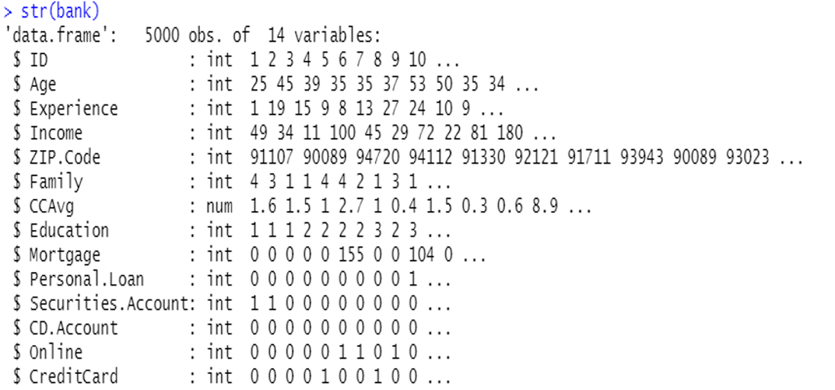
DATASET
Set the working directory and read the dataset
There are 5000 rows and 14 columns
Data cleaning
1. Checked for missing values, duplicate records, check data types of all the variables
2. Dropped column ‘ID’ as it was insignificant and converted categorical variables into factor variables

Slide 3
EXPLORATORY DATA ANALYSIS
Exploratory Data Analysis (EDA) was conducted which could give some insights to the bank management with regards to decision making
Out of the total 5000 customers, 4520 have not been approved for a loan while 480 have been
To understand the impact of variables like ‘Age’ & ‘Income’, it is better to put them in a range or category
Avg Income of customers tends to be higher when there are less family members
Personal loan has been approved for customer having a higher income
Customers belonging to the rich group have the highest amount of Mortgage
More educated customers have a higher Credit Average
CC Avg is similar for customers who opted for online service and for those who did not

Slide 4
LOGISTIC REGRESSION
Ran Logistic regression using the ‘glm’ function
Used the stepwise function which will include all the independent variables and start removing the insignificant variables one after the other. ‘Zipcode’ variable was removed
Checked for multicollinearity in the model by using the VIF function and found ‘Age’, ‘Income’ and ‘Age_range’ having values higher than 5. ‘Age_range’ was removed.
Split the data into train and test (80/20) by using createDataPartition function
Use the train data to create the model and the test data for prediction

Slide 5
IMBALANCED DATA
Out of the total 5000 customers, 4520 have not been approved for a loan while 480 have been. This proved that the data was imbalanced.
To balance the data, we used the library ‘ROSE’ and ‘ovun.sample’ function.
We used the test data to predict over_data, under_data and both_data & confusion matrix to provide the accuracy, sensitivity and specificity
Logistic regression for over_data: Accuracy is 92.1%, Sensitivity is 94.79% and Specificity is 91.81%
Logistic regression for under_data: Accuracy is 92.1%, Sensitivity is 95.83% and Specificity is 91.70%
Logistic regression for both_data: Accuracy is 92.2%, Sensitivity is 93.75% and Specificity is 92.04%

Slide 6
DECISION TREE
We ran the library ‘rpart’ and set the seed
We used the test data to predict over_data, under_data and both_data & confusion matrix to provide the accuracy, sensitivity and specificity
Decision Tree for over_data: Accuracy is 92.8%, Sensitivity is 98.96% and Specificity is 92.15%
Decision Tree for under_data: Accuracy is 93.70%, Sensitivity is 98.96% and Specificity is 93.14%
Decision Tree for both_data: Accuracy is 94.50%, Sensitivity is 94.79% and Specificity is 94.47% - DT for both_data

Slide 7
RANDOM FOREST
We ran the library ‘randomForest’ and set the seed
We used the test data to predict over_data, under_data and both_data & confusion matrix to provide the accuracy, sensitivity and specificity
Random Forest for over_data: Accuracy is 98.50%, Sensitivity is 92.71% and Specificity is 99.12%
Random Forest for under_data: Accuracy is 95.70%, Sensitivity is 98.96% and Specificity is 95.35%
Random Forest for both_data: Accuracy is 98.40%, Sensitivity is 97.92% and Specificity is 98.45%

Slide 8
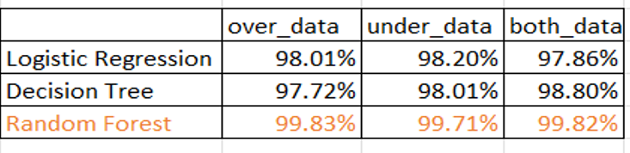
ROC AND AUC
We ran the library(pRoC)
Used roc function to predict the AUC for over_data,under_data, both_data for Logistic Regression, Decision Tree & Random Forest
Conclusion: From the above, it clearly shows that Random Forest is the best model

